Slide 1
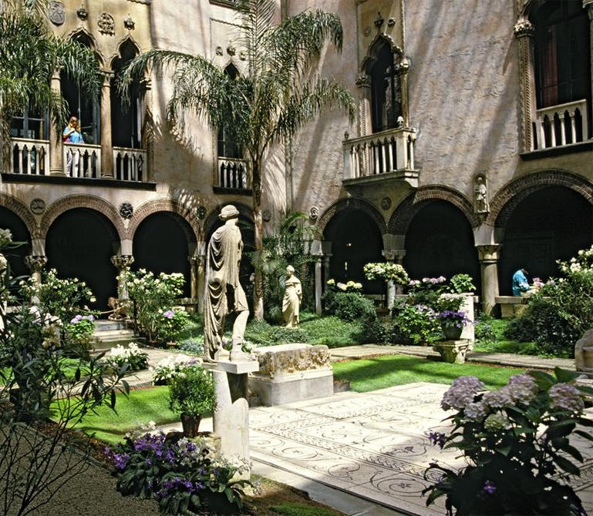
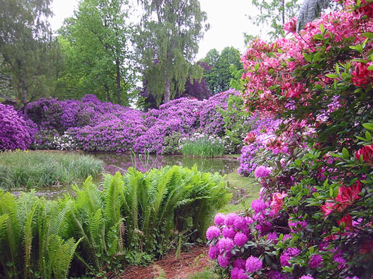
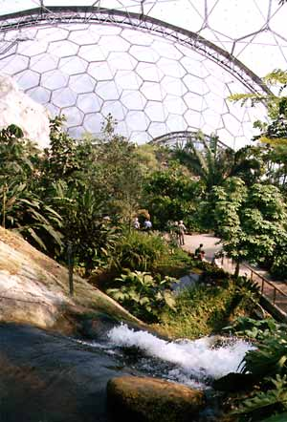
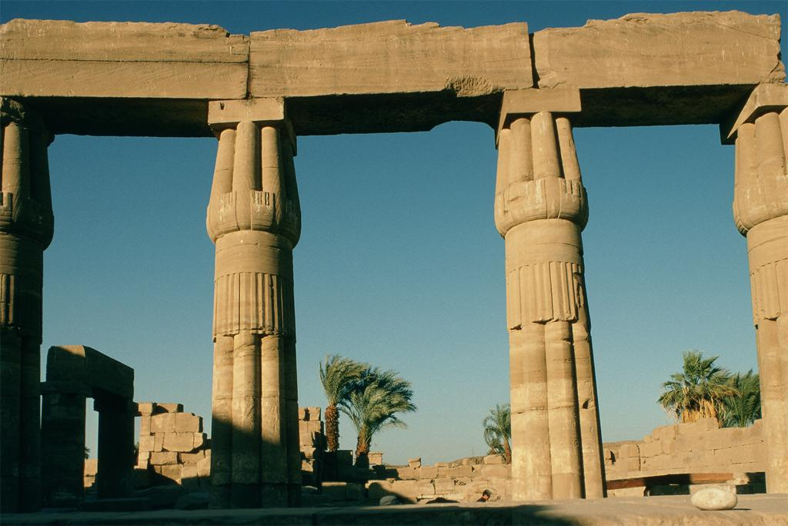
Longwood Gardens

Slide 2
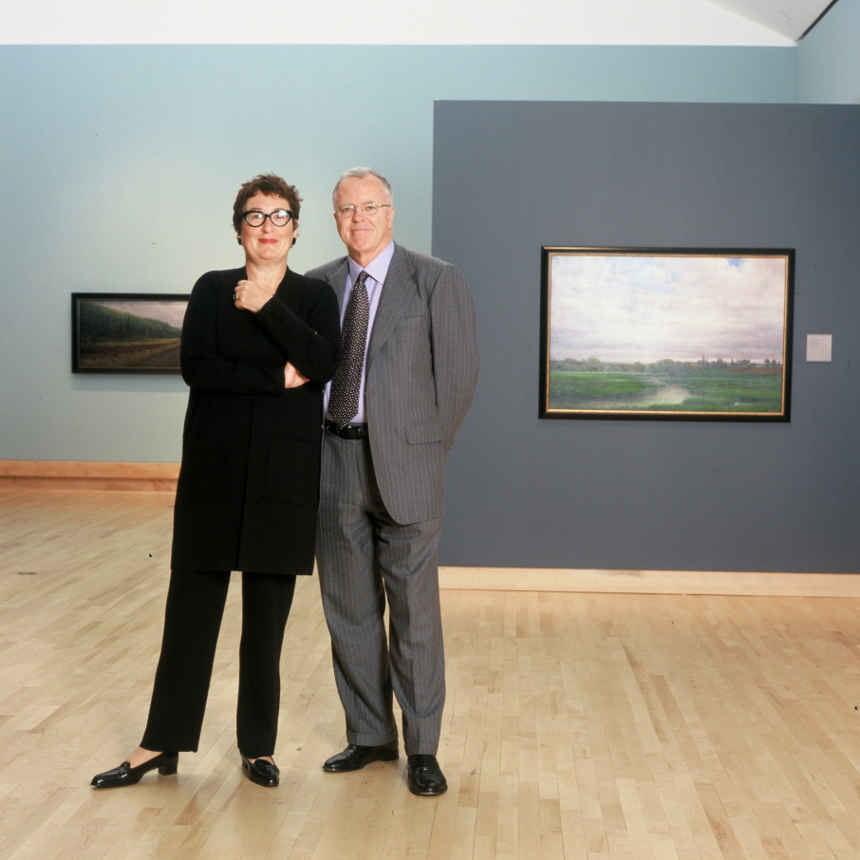
People, Plants, Collections:
Making the Connections
Longwood Graduate
Program Symposium
March, 2010
Keynote Address:
Cultural Change
and Public Gardens
Gail and Barry Lord
Co-Presidents
Lord Cultural Resources

Slide 3
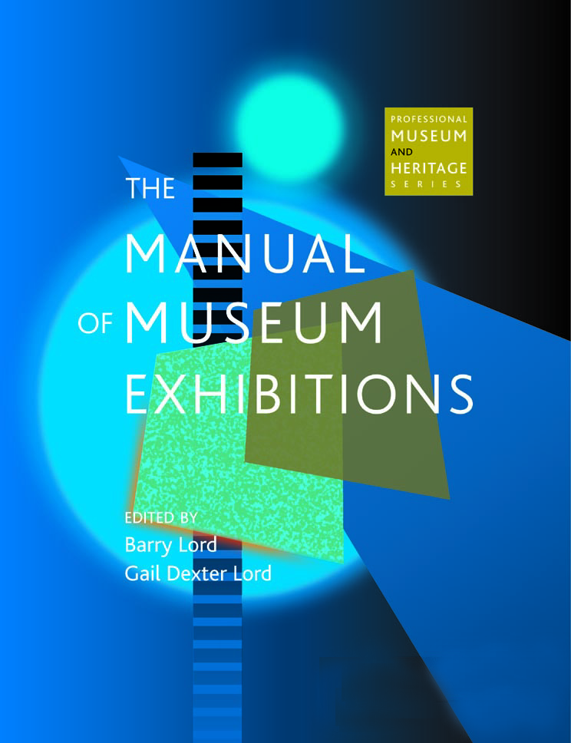
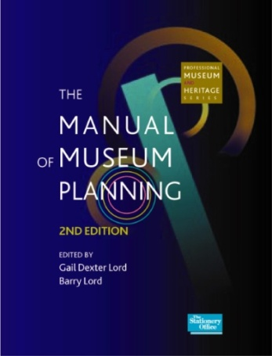
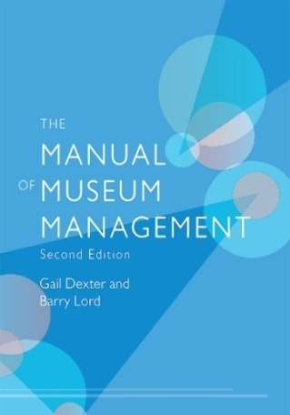
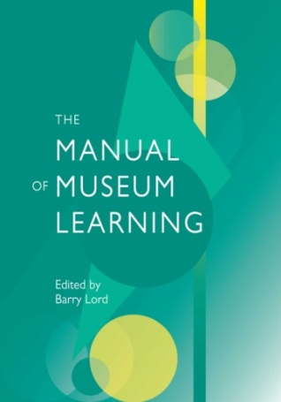
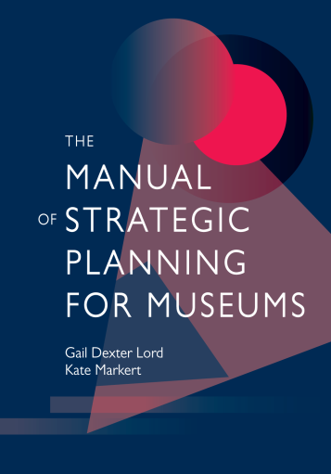
Lord Cultural Resources

Slide 4
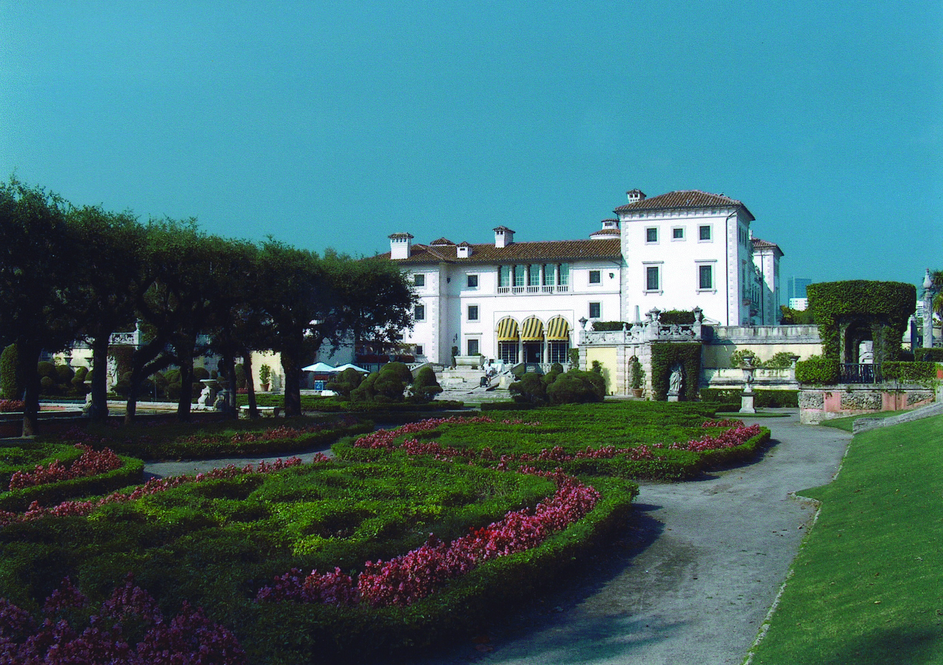
Vizcaya Museum and Gardens, Miami

Slide 5
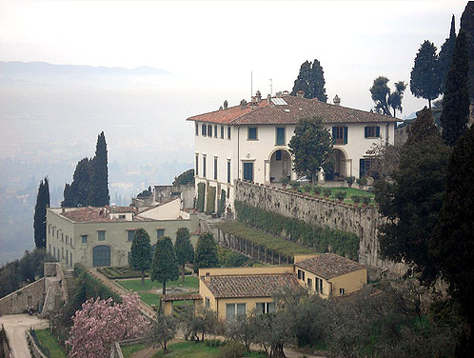
Villa Medici, Fiesole

Slide 6
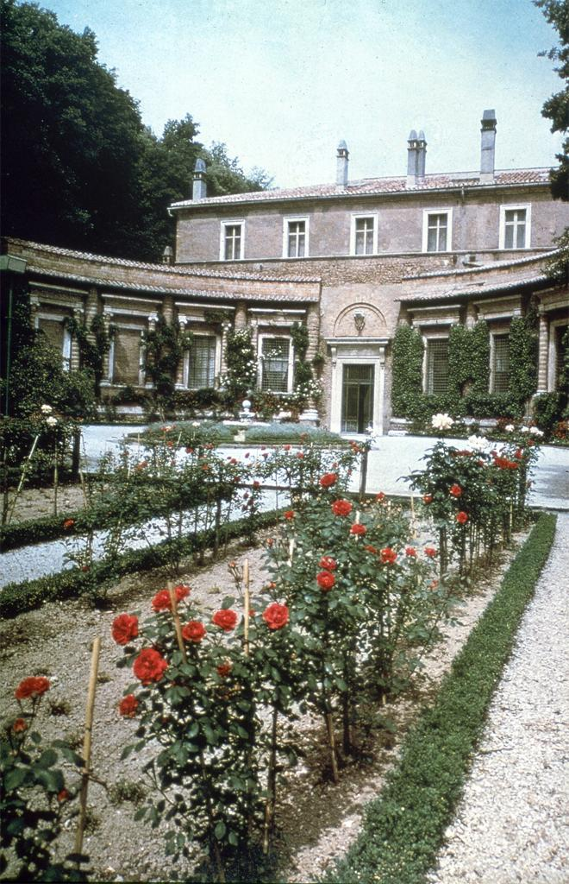
Villa Madama
Villa Madama, designed by Raphael, 1518

Slide 7
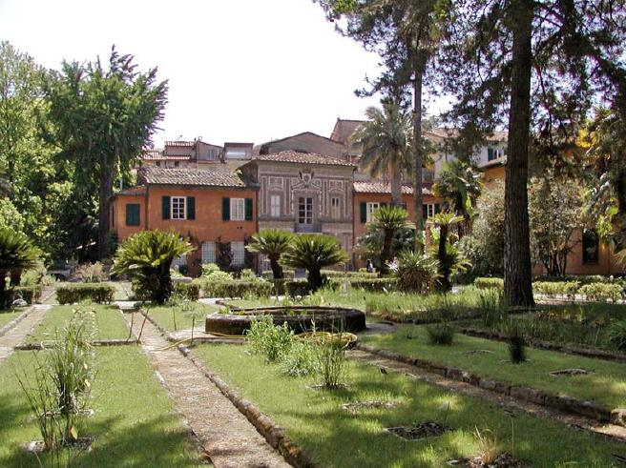
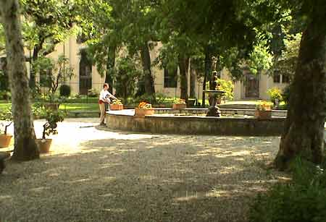
Public Garden, University of Pisa

Slide 8
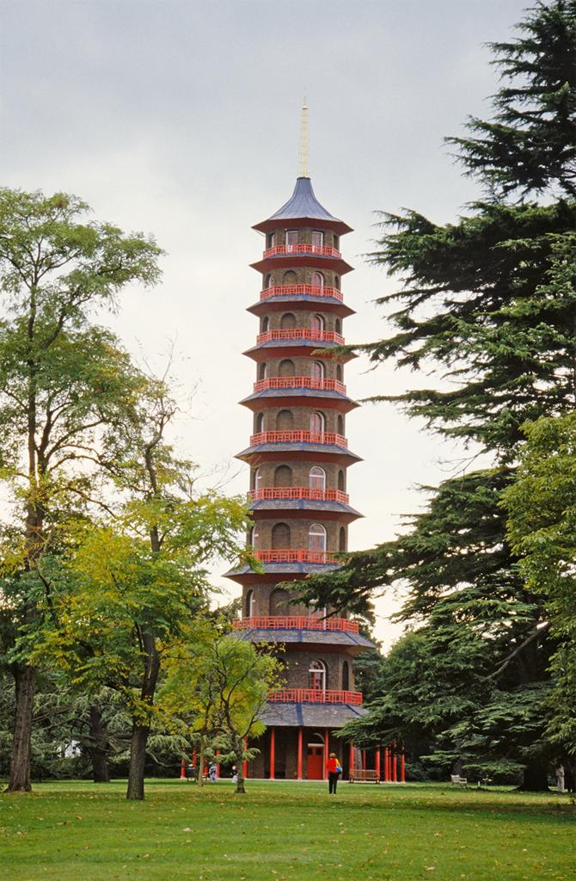
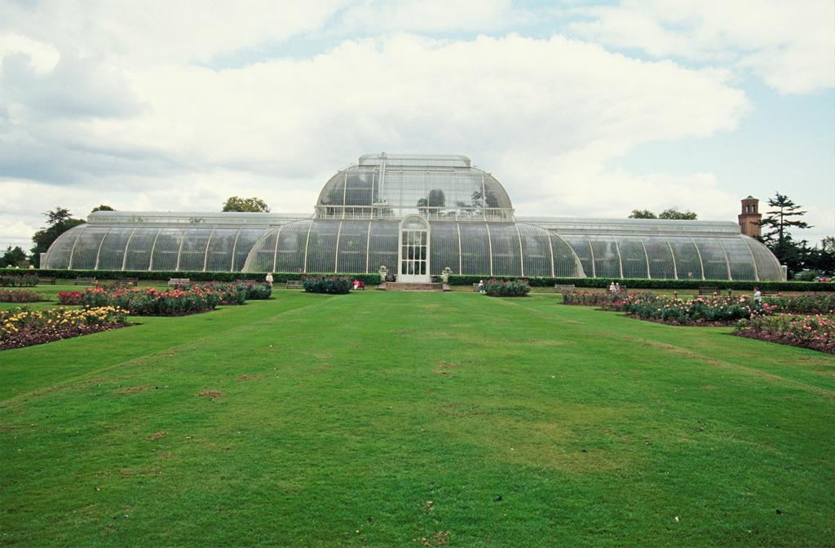
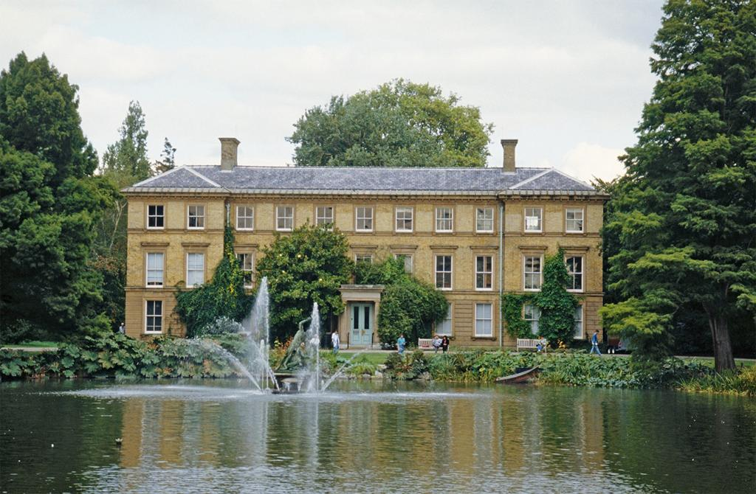
Royal Botanic Gardens, Kew
Clockwise: Palm House, rebuilt in1984–89;
Building at east end of large pond;
Kew Gardens Pagoda, Sir William Chambers, architect

Slide 9
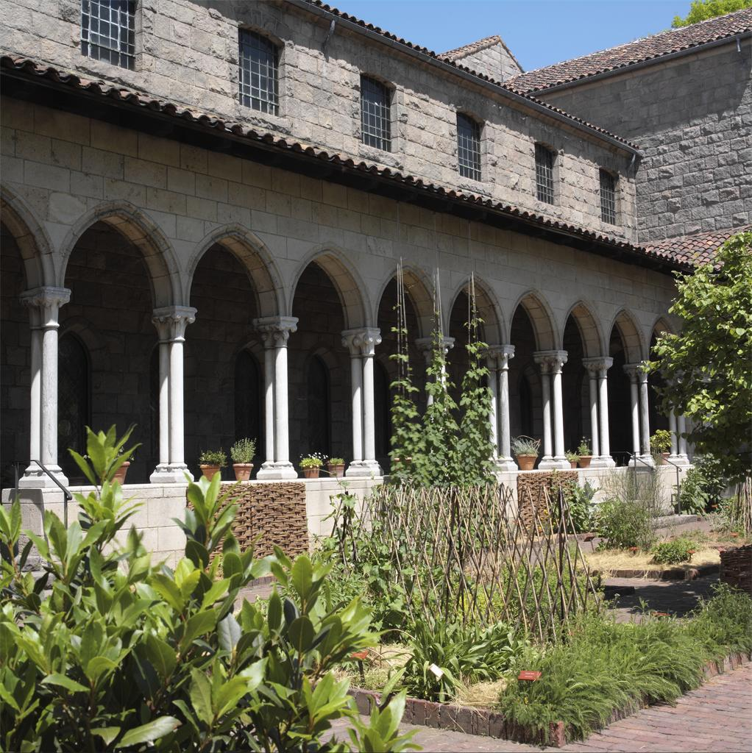
Cloister Arcades, Metropolitan Museum, New York

Slide 10
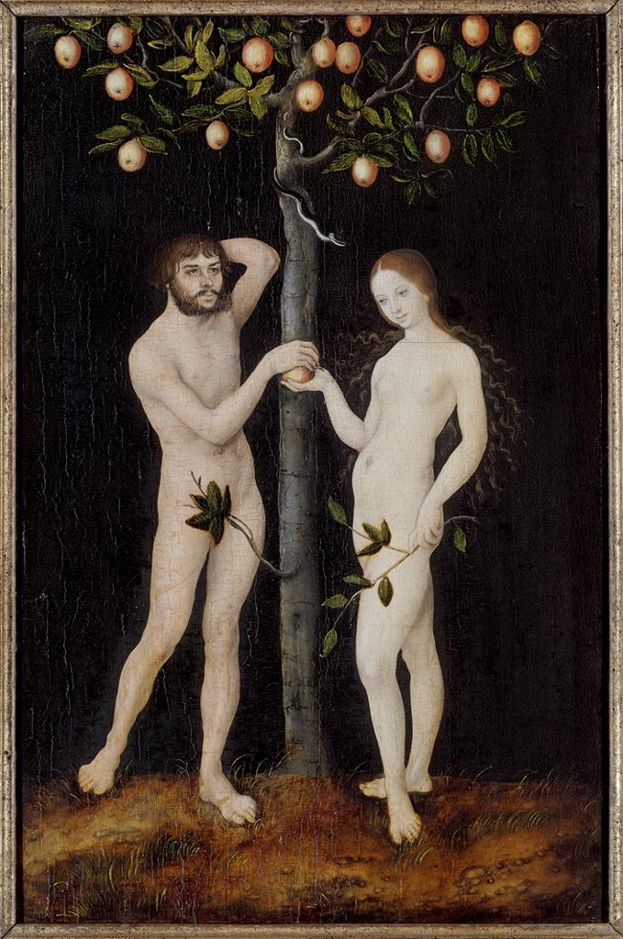
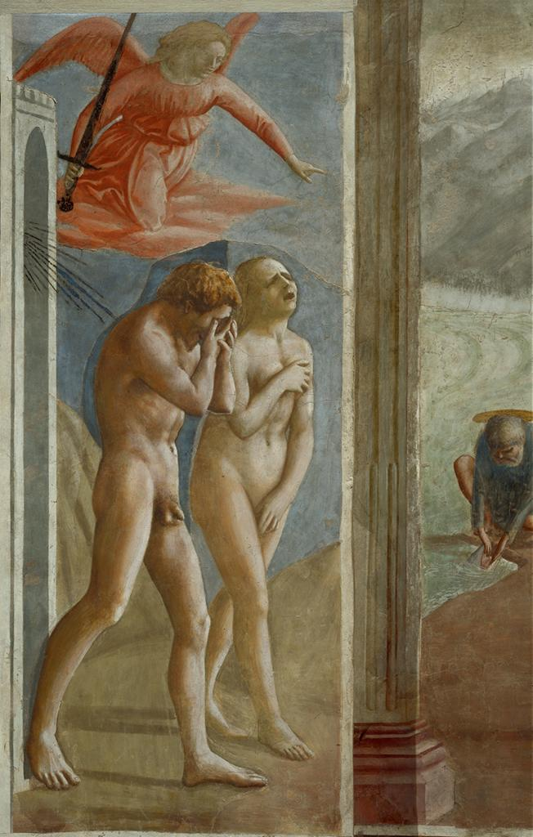
Adam and Eve, The Garden of Eden
Lucas Cranach the Elder (1472-1553),
Adam and Eve, 1521,
Koninklijk Museum voor Schone Kunsten, Brussels
Masaccio (1401-28),
Expulsion of Adam and Eve from the Garden of Eden,
fresco, 1424-6,
Brancacci Chapel, Florence

Slide 11
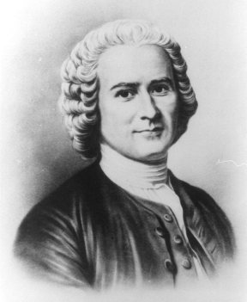
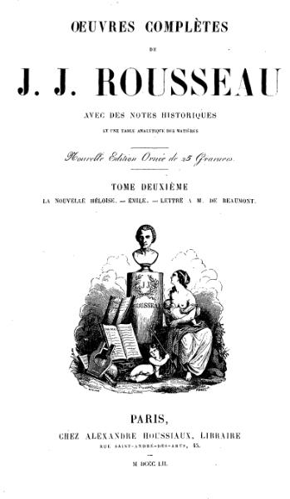
Jean-Jacques Rousseau

Slide 12
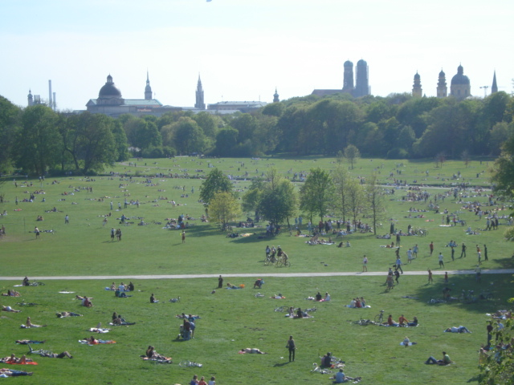
Englischer Garten, Munich

Slide 13
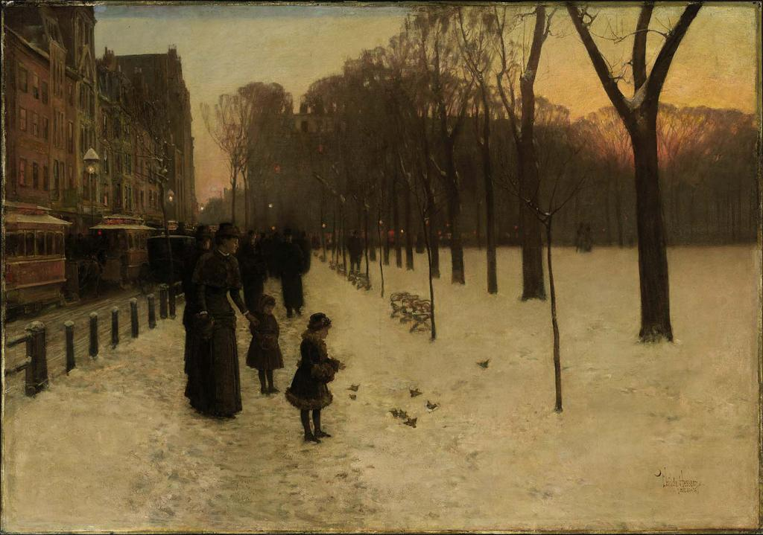
Boston Common
Frederick Childe Hassam (1859–1935), Boston Common At Twilight, c. 1885, Museum of Fine Arts Boston

Slide 14
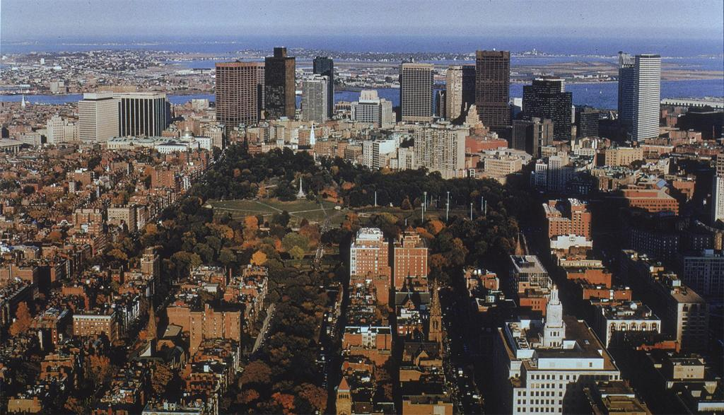
Boston Common and Public Gardens
Boston Common and Public Gardens

Slide 15
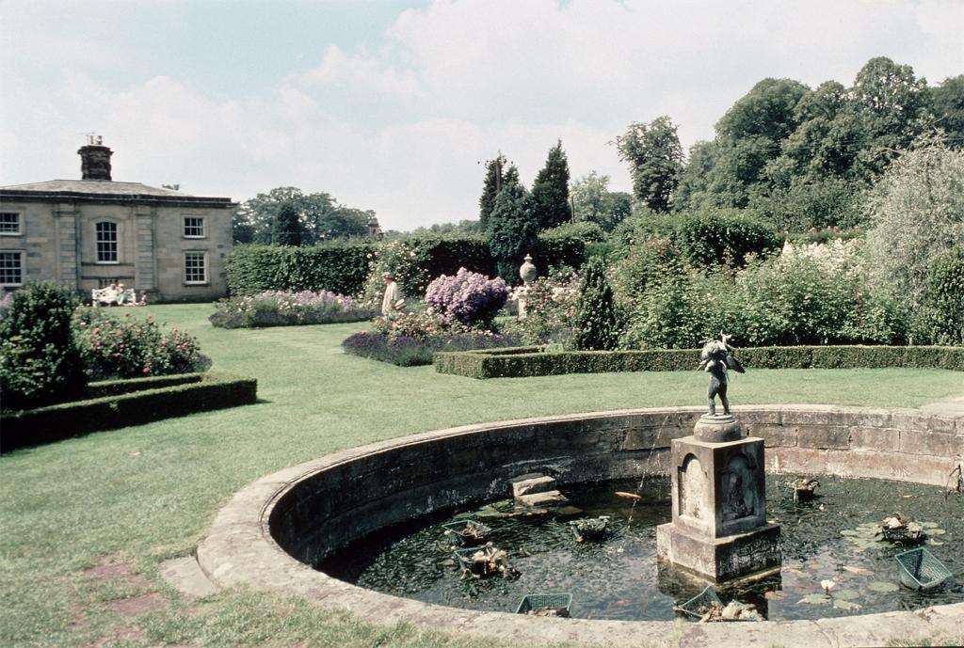
Castle Howard, Yorkshire

Slide 16
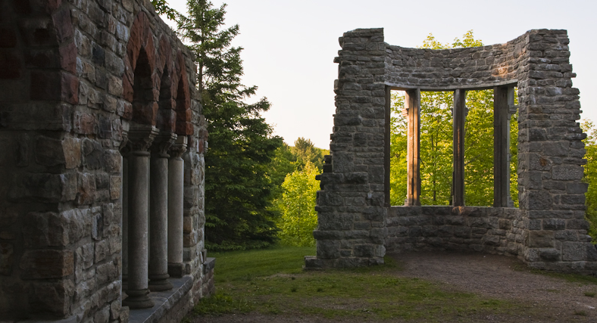
Kingsmere
Photograph: Glenn Bloodworth

Slide 17
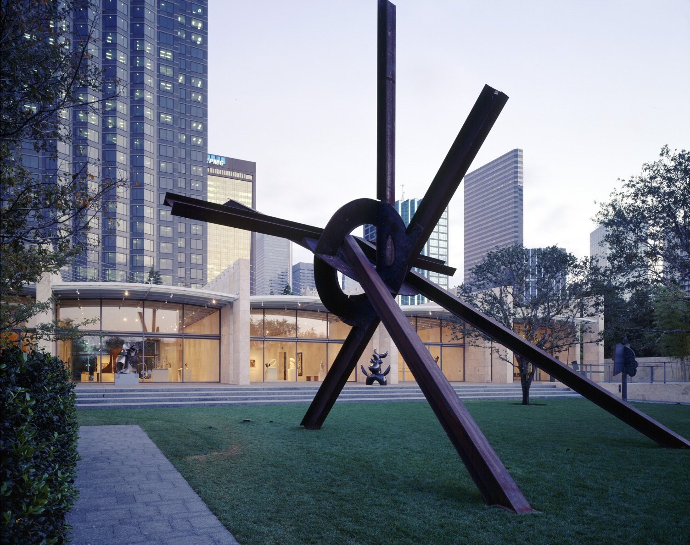
Nasher Sculpture Park, Dallas

Slide 18
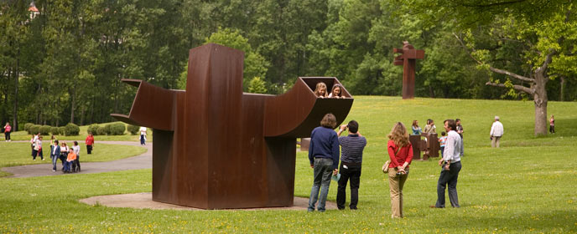
Eduardo Chillida Sculpture Park,
Spain

Slide 19
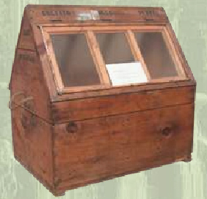
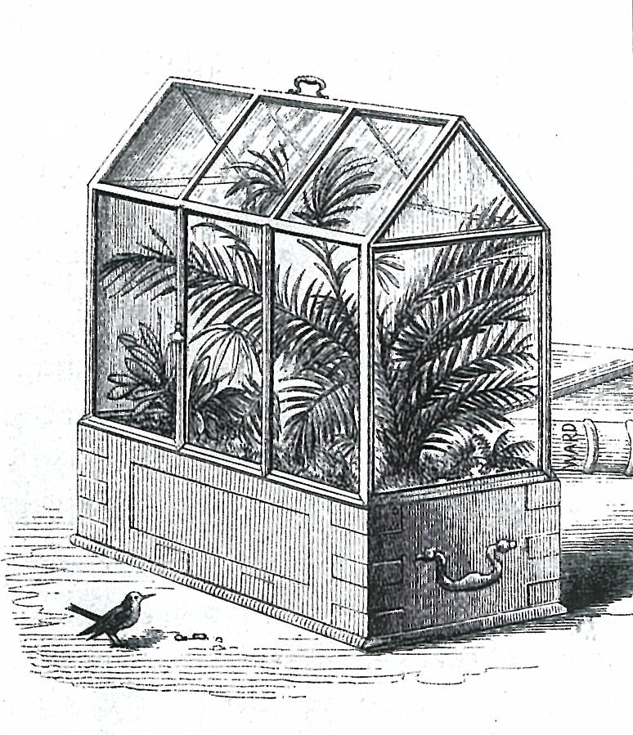
The Wardian Case
The Wardian Case for carrying plant specimens, invented by Nathaniel Ward, 1829

Slide 20
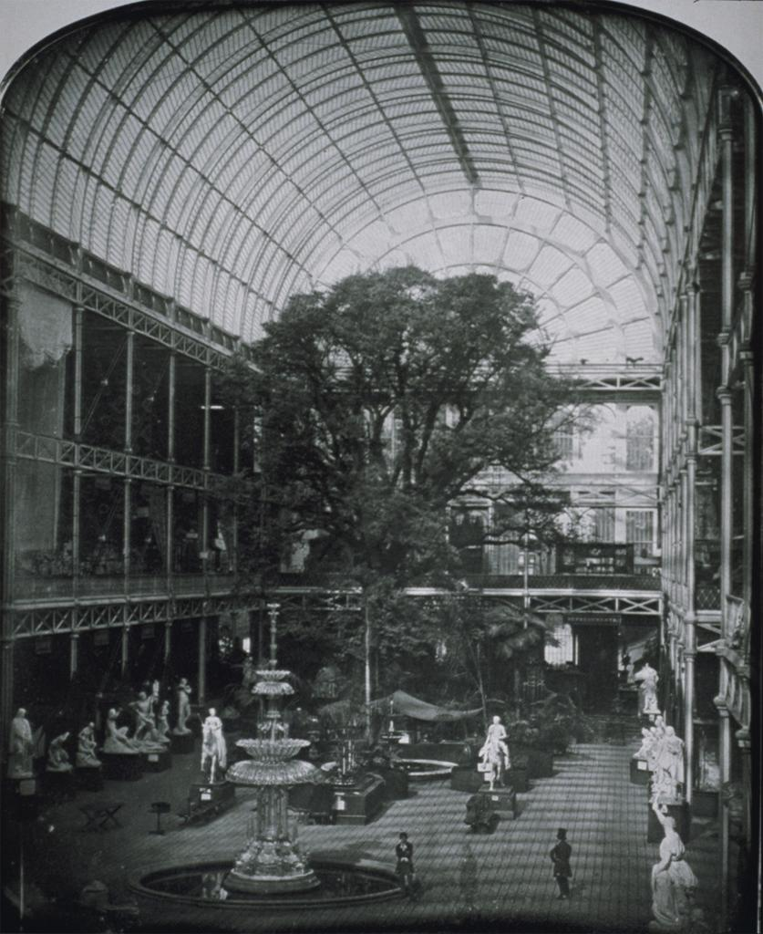
The Crystal Palace, 1851
Sir Joseph Paxton (1803-65), designer;
John Edwin Mayall (1810–1901), photographer

Slide 21
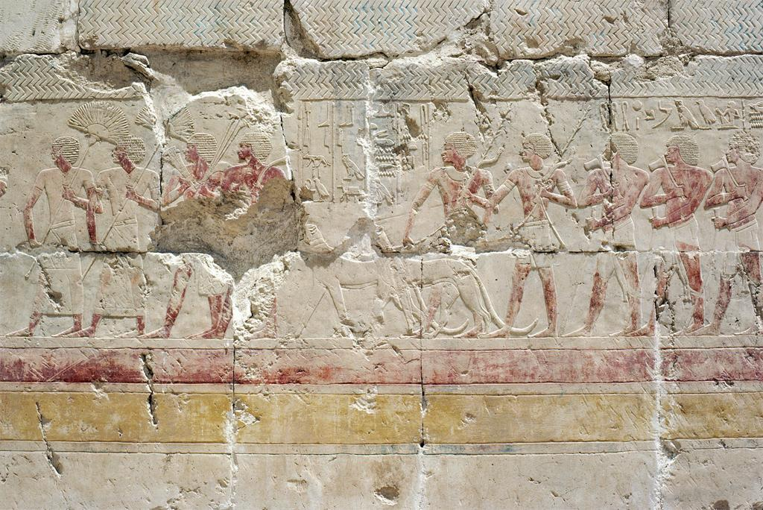
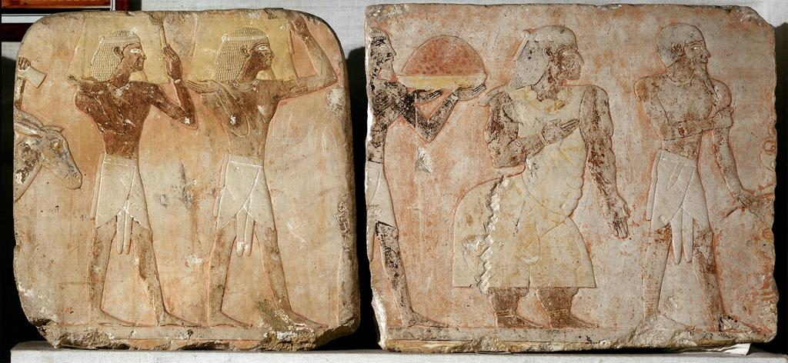
Deir-el-Bahri, Egypt
Left to right: Middle colonnade of the southern wall, Deir El Bahri;
Expedition to the Land of Punt, c. 1473–58 BCE;
From the Funerary Temple of Hatshepsut

Slide 22
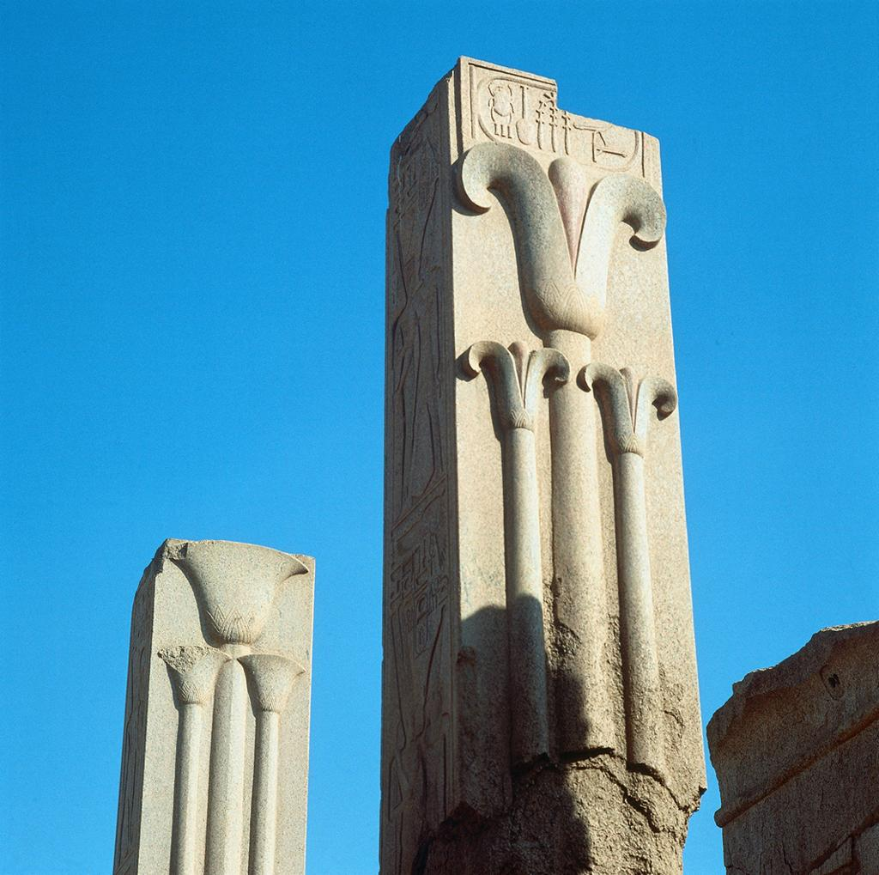
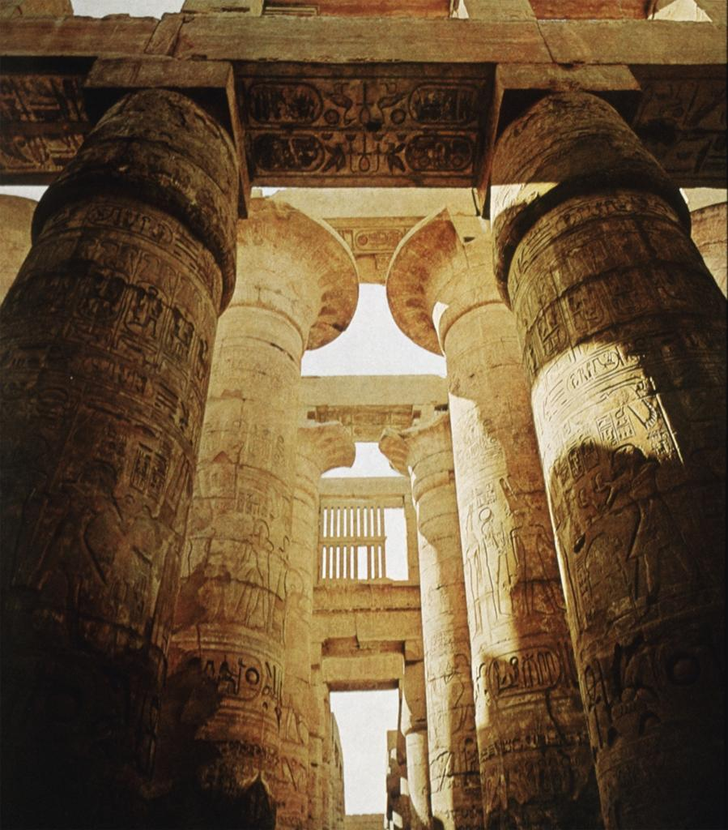
“The Botanical Garden”, Karnak
Temple of Amon-Re at Karnak

Slide 23
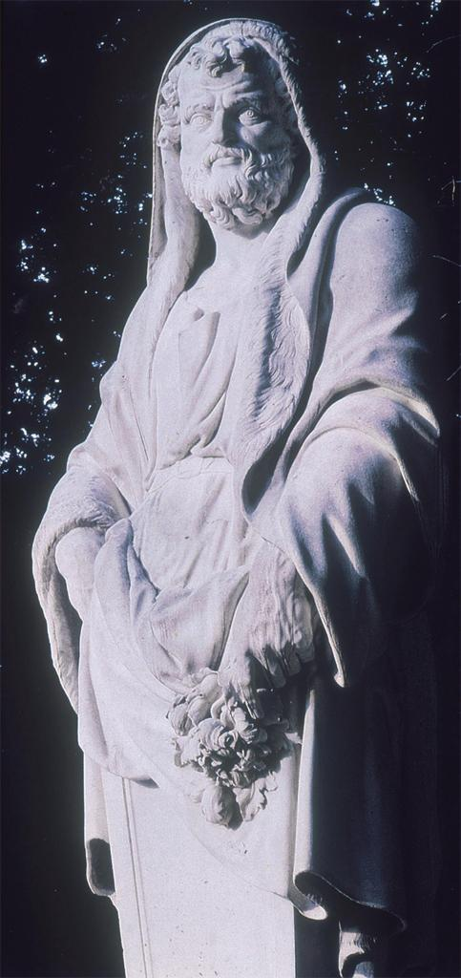
Theophrastus (c. 371–287 BCE)
Term of Theophrastus,
North Parterre, “Crossroads of Philosophers”, Versailles

Slide 24
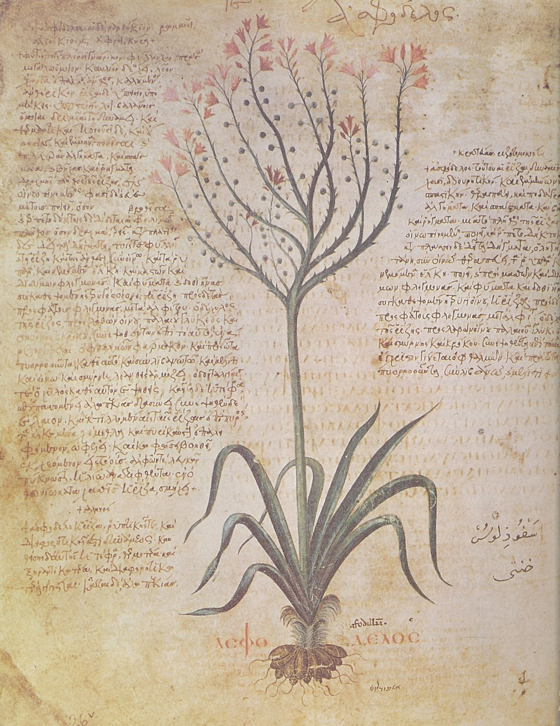
Dioscorides’ De Materia Medica
Asphodelus ramosus,
From Codex Vindobonensis, c. 512 CE Byzantine copy of Dioscorides’ De Materia Medica, 1st century CE

Slide 25
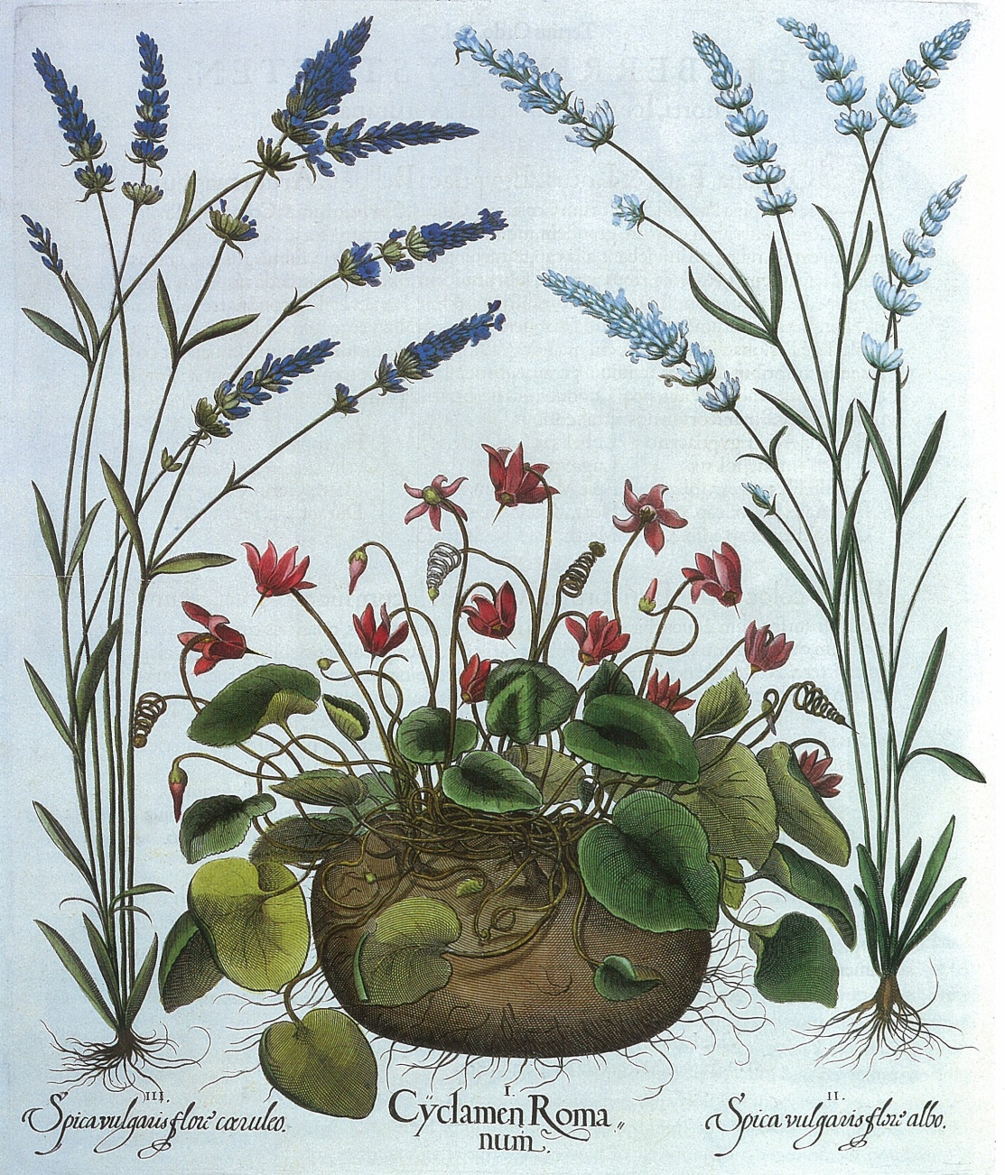
The influence of engravings
Basilius Besler,
Cyclamen hederifolium with Lavandula stoechas, Engraving, Hortus Eystettensis, Germany, 1613

Slide 26
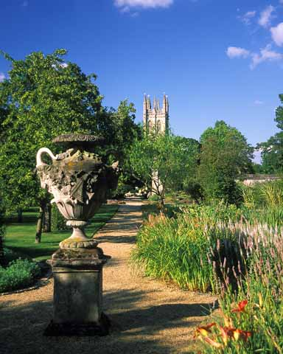
Oxford University Botanical Garden

Slide 27
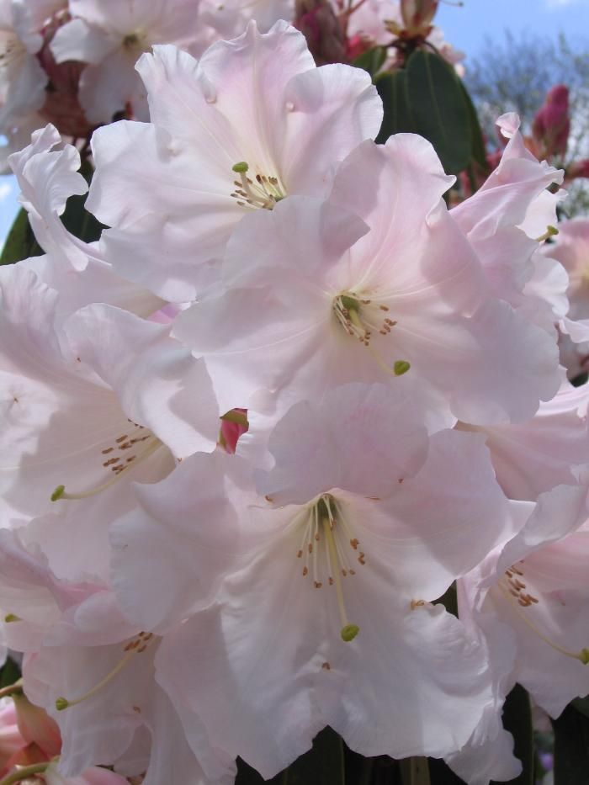
Rhodondendron loderi

Slide 28
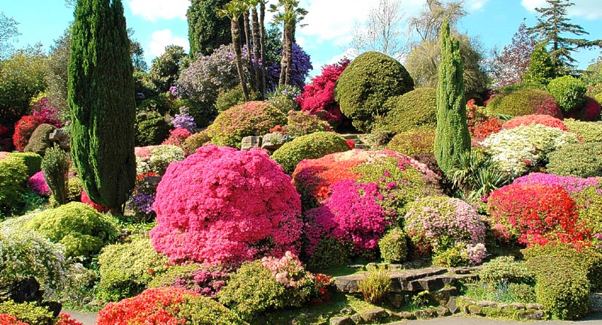
Leonardslee, Sussex

Slide 29
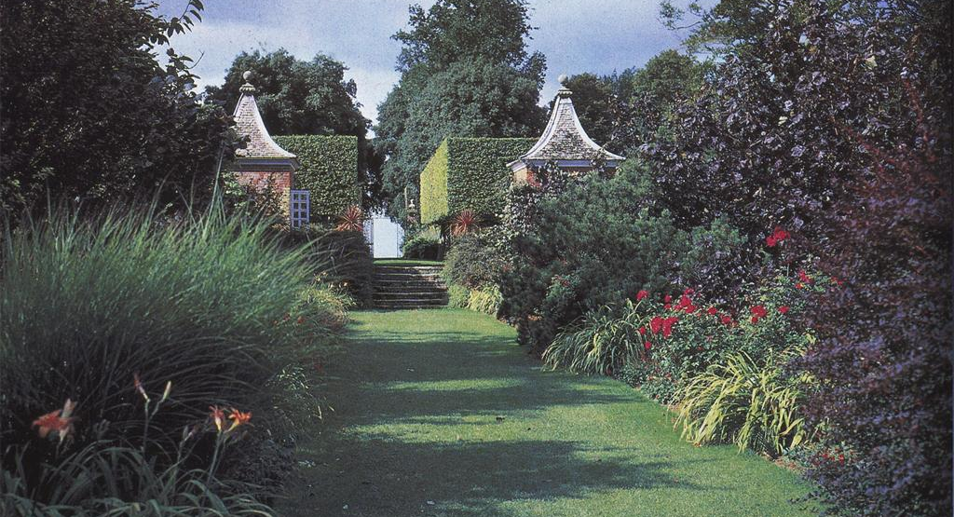
Hidcote, Gloucestershire

Slide 30
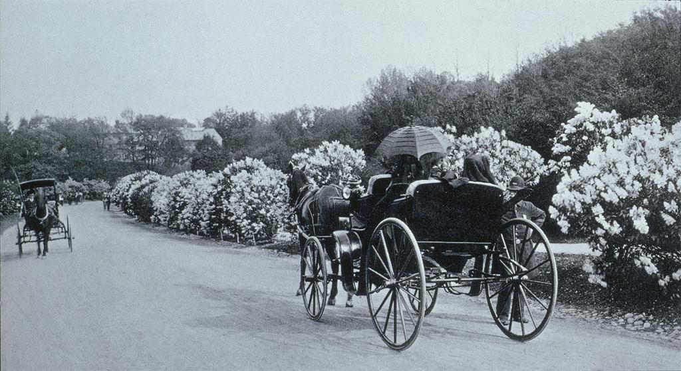
Arnold Arboretum, Harvard University
Frederick Law Olmsted (1822-1903) designer, Arnold Arboretum, 1872

Slide 31
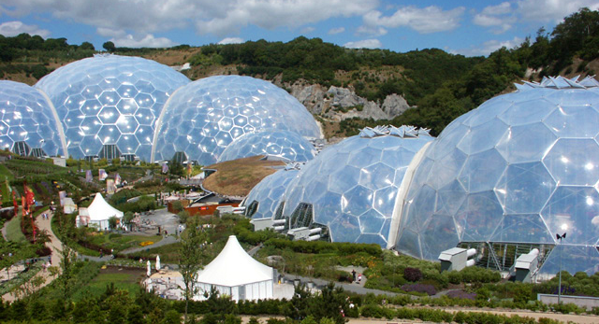
Eden Project, Cornwall

Slide 32
Eden Project, Cornwall

Slide 33
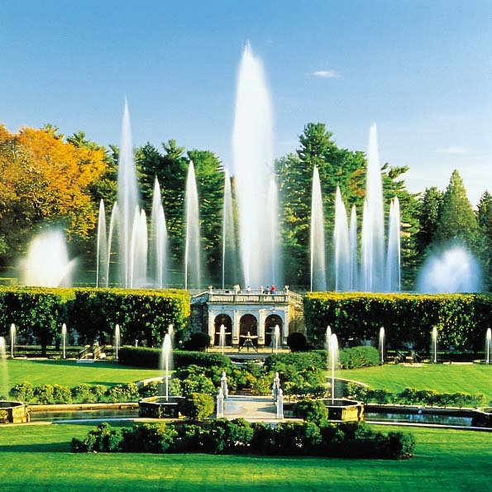
Longwood Gardens

Slide 34
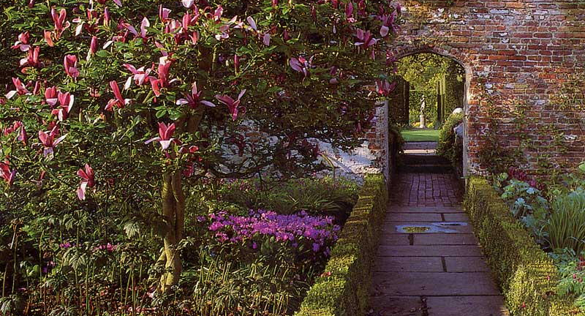
Sissinghurst Castle Garden

Slide 35

Connecting Collections to the Public –
Interpretive Planning
Mandate
Mission
Themes
Communication Objectives
Means of Expression

